Slide 1
Collaborative Risk Management
Calvin Lee
calvin.lee@teamsupport.net
+31 6 28 998 133

Slide 2
RISKID company profile
Founded in 2009 as a technical startup company from the Delft University of Technology in the Netherlands.
HQ in the Netherlands. Regional offices in:
Wuxi (China)
Sao Paolo (Brazil)
Kuala Lumpur (Malaysia)
The fastest growing risk management tool provider in the Netherlands.
Development collaboration with various universities in the Netherlands, Belgium, England, Germany and Malaysia.
Notes:
Probably remove this slide and add client’s credentials and intro. Clients also usually add slides depicting their risk framework or risk processes.

Slide 3
What is RISKID?
RISKID is a risk management tool that focuses on two aspects: collaboration and ease of use.
We believe effective risk management can only be achieved by involving all stakeholders and raising their risk awareness. In a very simple and practical way.
Notes:
This would typically be the first slide about RISKID.

Slide 4
What we do differently
While other vendors say their software is user-friendly, our software is scientifically proven to be user-friendly.
While other vendors say their software is effective and efficient, our software is scientifically proven to identify and evaluate risks in 60% less time.
Notes:
1. Experience with Self-Guiding Group Support Systems for Creative Problem Solving Tasks, Mesquita, published by Information Science Reference, ISBN 978-1-60960-519-3.
2. Fifteen Years of GSS in the Field, de Vreede, Vogel, Kolfschoten, Wien.

Slide 5
Benefits
Shared.
Engage all relevant stakeholders and create risk awareness
Simple.
Ease of use is in our DNA: in communication and design
Swift.
Scientifically proven to identify and evaluate risks in 60% less time

Slide 6
Case studies
Province of South Holland
Successfully delivered a fully customized RISKID as their ERM system for the whole organization (Policy, Infrastructure Projects, Strategy, etc.). Customized functionalities include: risk quantification, data connection with their own data warehouse, customized reports and dashboards, and many other functionalities specific for their way of working.
Arcadis, consulting engineering firm
Implemented RISKID as their main RM software for their risk and project management consulting services.
Notes:
Probably can be removed, unless you need to convince client of RISKID’s experience and credentials.

Slide 7
We sponsor great initiatives
Notes:
Probably can be removed, unless you need to convince client of RISKID’s experience and credentials.

Slide 8
What clients say
“Collaborative and innovative are the keywords for me when I think of RISKID. The things I appreciate the most in the cooperation with RISKID is their cooperative thinking and flexibility of the people. Additionally, the software is a great tool to involve a lot of employees in the process. This creates awareness and stakeholder involvement, and evidently continuity!”
Wopke De Jong
Business Development Manager at Avéro Achmea, largest insurance company in the Netherlands
Notes:
Probably can be removed, unless you need to convince client of RISKID’s experience and credentials.

Slide 9
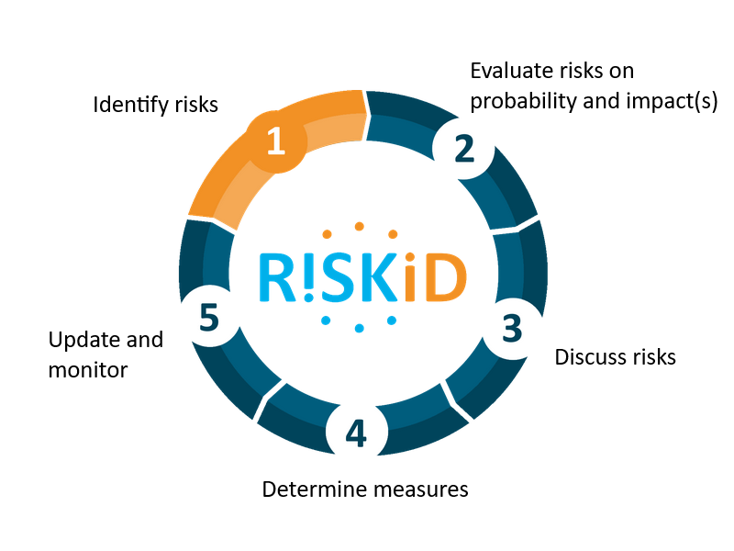
How RISKID works
Notes:
Identify - All relevant risks are swiftly and efficiently identified by the right stakeholders in an online environment.
Score - Risks are scored on probability and impact and automatically generated as input for the risk meeting.
Discuss - Risks are discussed for shared understanding and ownership within the group.
Mitigate - Appropriate measures are defined for the top risks. Risk owners and measure owners are assigned to manage risks.
Monitor - Risk and measure owners can always update information, while auto alerts and dashboards keep everyone on track.

Slide 10
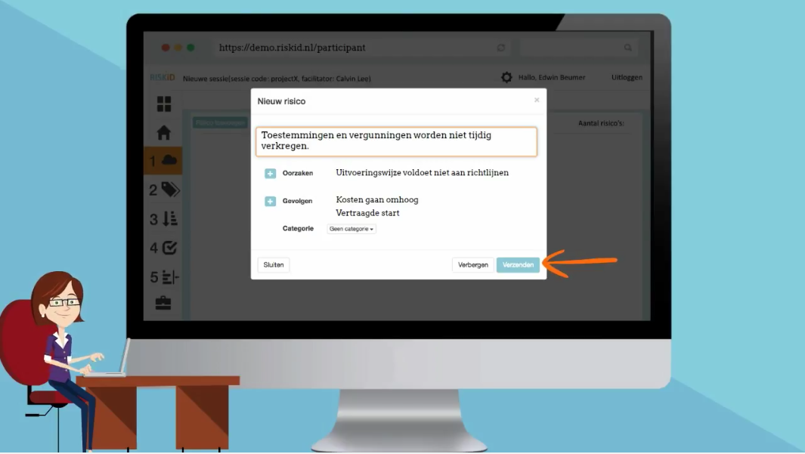
1. Identify risks
Notes:
Risk brainstorm in RISKID video (1,5 minute):
https://youtu.be/78eJyljMIJY

Slide 11
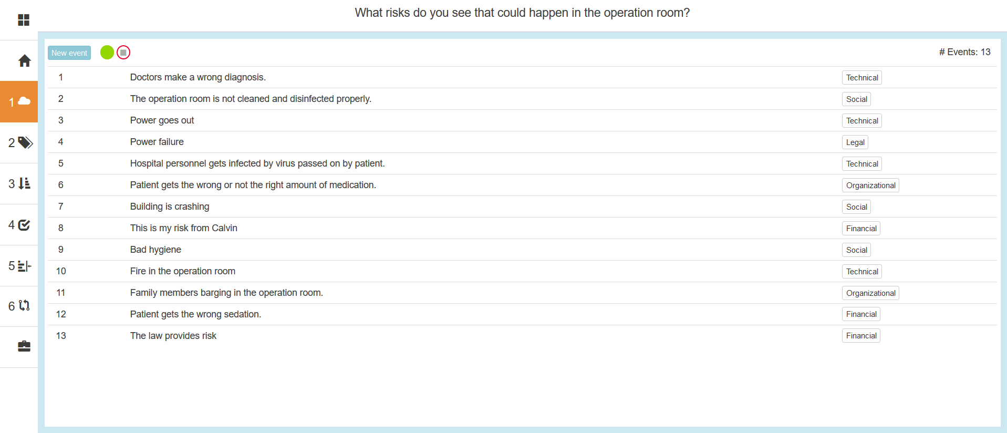
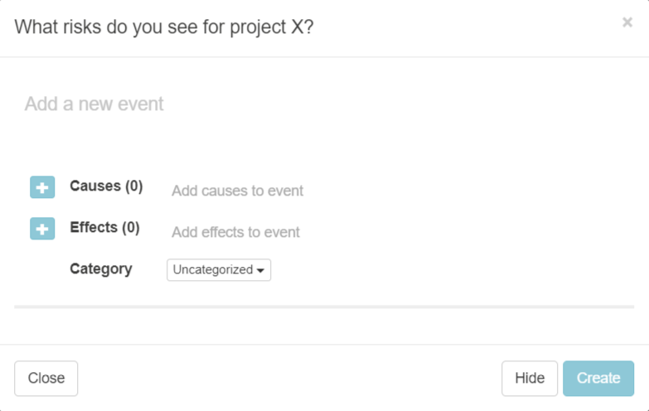
1. Add risks, causes and effects
Notes:
Risk brainstorm in RISKID video (1,5 minute):
https://youtu.be/78eJyljMIJY

Slide 12
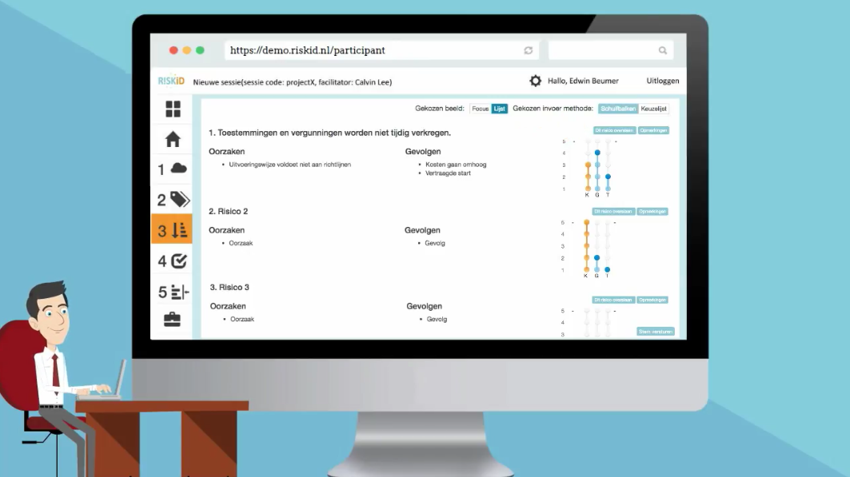
2. Score risks
Notes:
Risk scoring in RISKID video (1,5 minute):
https://youtu.be/xN7fvvdUmYA
The idea is that you actually don’t have to come together yet when you are individually scoring the risks. It is your personal estimation on probability and impact of the risk. When doing this online you will gain a lot of efficiency.
Each participant also reads the risks that are raised by other participants. This way everyone gets an understanding of what the concerns are of others and thus raising the group’s risk awareness.

Slide 13
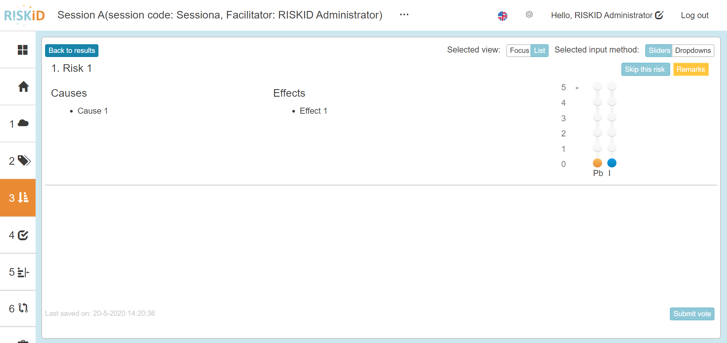
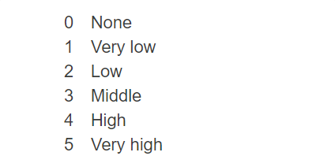
2. Score risks
Notes:
Risk scoring in RISKID video (1,5 minute):
https://youtu.be/xN7fvvdUmYA

Slide 14
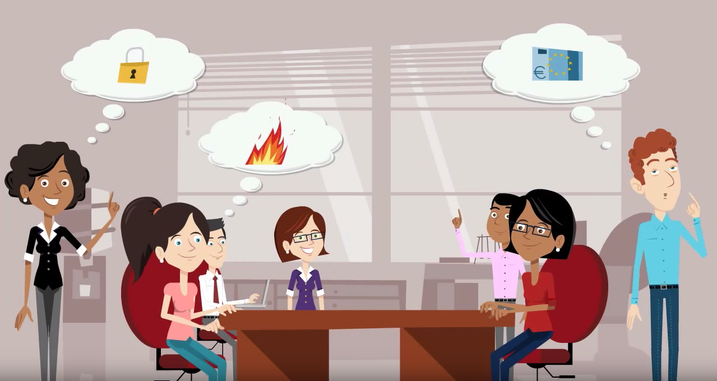
3. Discuss risks
Notes:
Discuss risks in RISKID video (1,5 minute):
https://youtu.be/XZh0Gwe8dYI

Slide 15
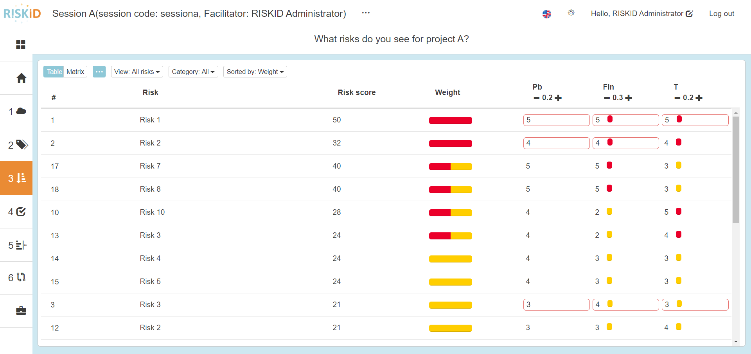
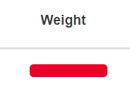
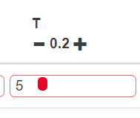
3. Discuss risks
Notes:
Discuss risks in RISKID video (1,5 minute):
https://youtu.be/XZh0Gwe8dYI

Slide 16
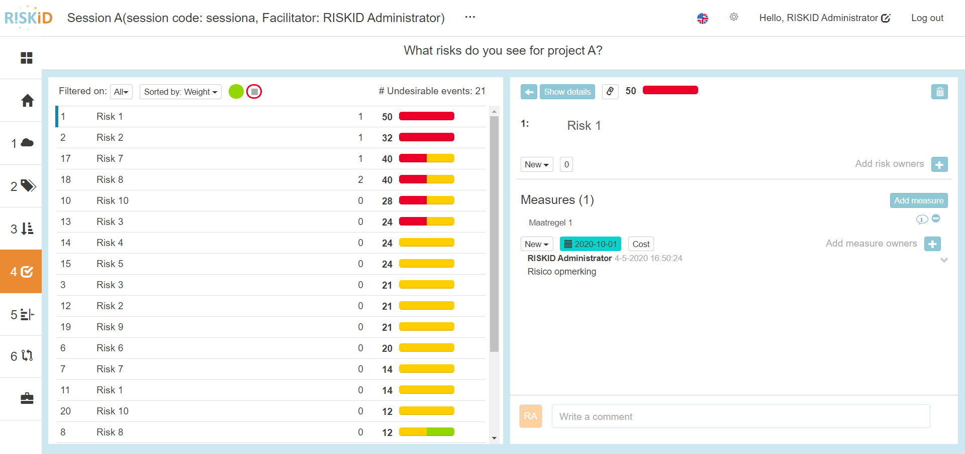
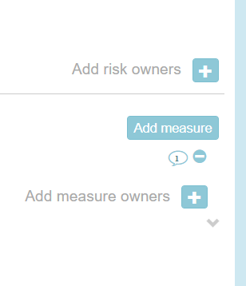
4. Determine measures

Slide 17
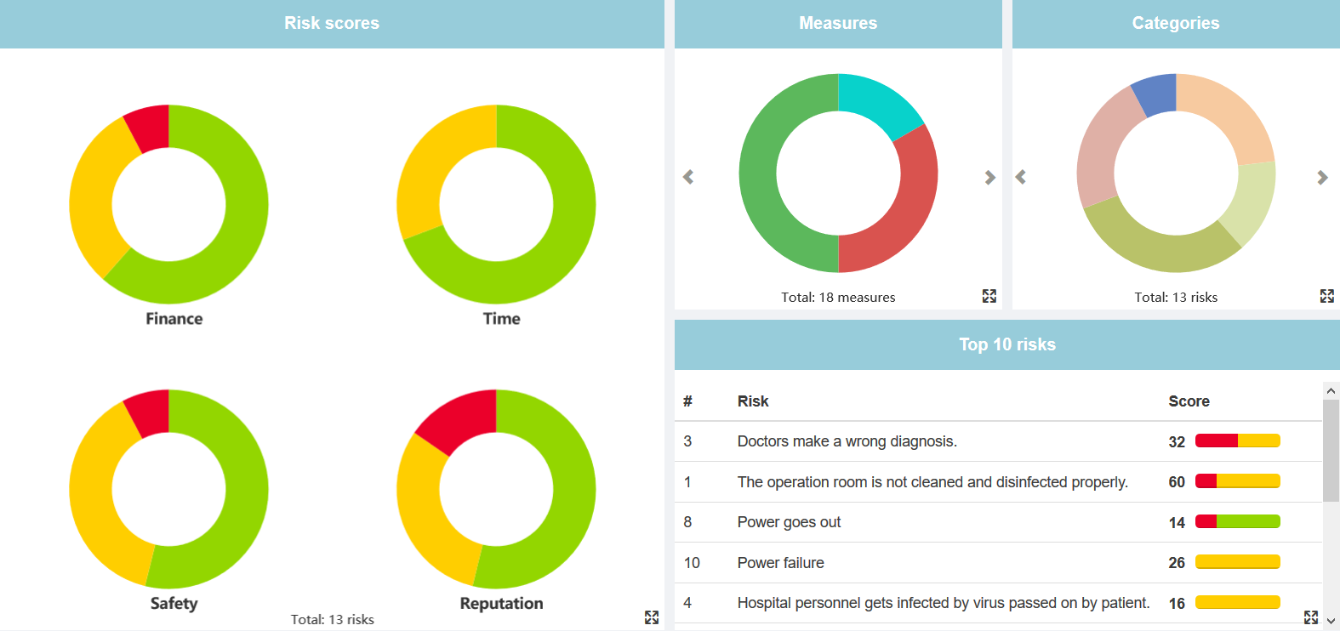
5. Monitor risks
Project dashboard provides the Project Manager a clear overview of aggregated risk data.
Risk scores widget: directly see how many critical risks there are.
Measures widget: directly see how many measures are due or overdue.
Top 10 widget: key risk data on the top 10 risks of a project.
RISKID dashboard widgets are clickable to enable you to drill down to specific
risk data whenever you need. F.e. Click on the Overdue measures in the pie chart
and view all overdue measures and the responsible action owners.
-> Triggers for higher management to make decisions and take action.
Notes:
Video (1,5 minutes):
https://youtu.be/9A0F8s2vfQg

Slide 18
Key functionalities
Collaborative risk sessions
Interactive dashboards
Accurate risk registers and risk matrix
Role-based monitoring and alerts
Risk response planning
Flexible reporting

Slide 19
RISKID’s USP
Simple design; in a very easy and understandable way all stakeholders are involved in the otherwise static risk management process. It creates an effective method to handle risks throughout the layers of the organization.
Collaboration; experts all agree that checklists and risk registers don’t work. But they have no choice; there are no good alternatives available. RISKID is the only tool that supports collaboration and group interaction, in a simple and attractive way.
Effective; with RISKID you are able to participate in the process anywhere, anytime and with any device. This way you get the right risks from the right people. Risk maturity can only be achieved by raising risk awareness, and our tool does just that: bringing people together to talk about risks.
Research shows a reduction in labour time > 50% and reduction in project time of 60% - 90%. Plus higher quality and better results.
Notes:
Excel doesn’t work video:
https://youtu.be/r6v4WtHTqlg

